Slide 1
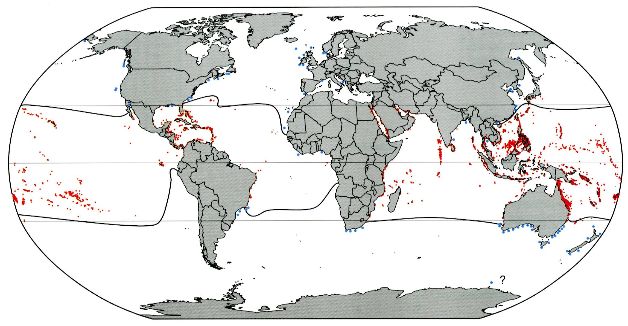
20°C winter isotherm

Slide 2
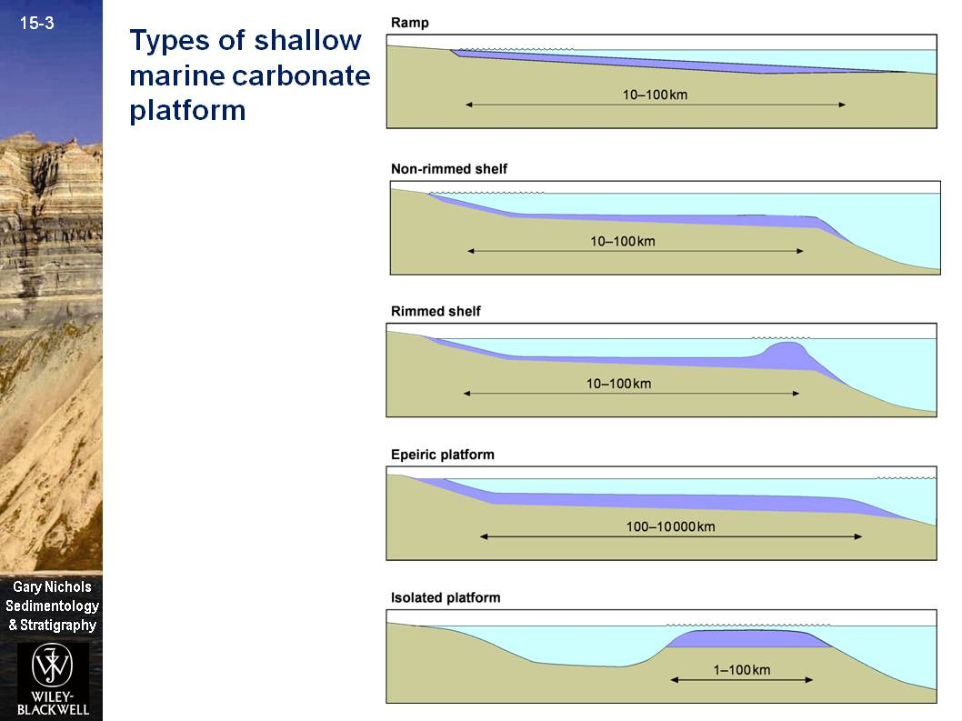

Slide 3
Carbonate platform exercise:
You are provided with paired global palaeogeographic and climate maps for the Upper Jurassic and Eocene (source: http://www.scotese.com). A legend for the paleoclimate indicators is provided.
For each case, discuss the following:
1. Where would you predict carbonate platforms?
2. What platform types would you predict in each area?
3. Examining the map, what environmental and tectonic controls can you identify that would have promoted that particular platform type?

Slide 4
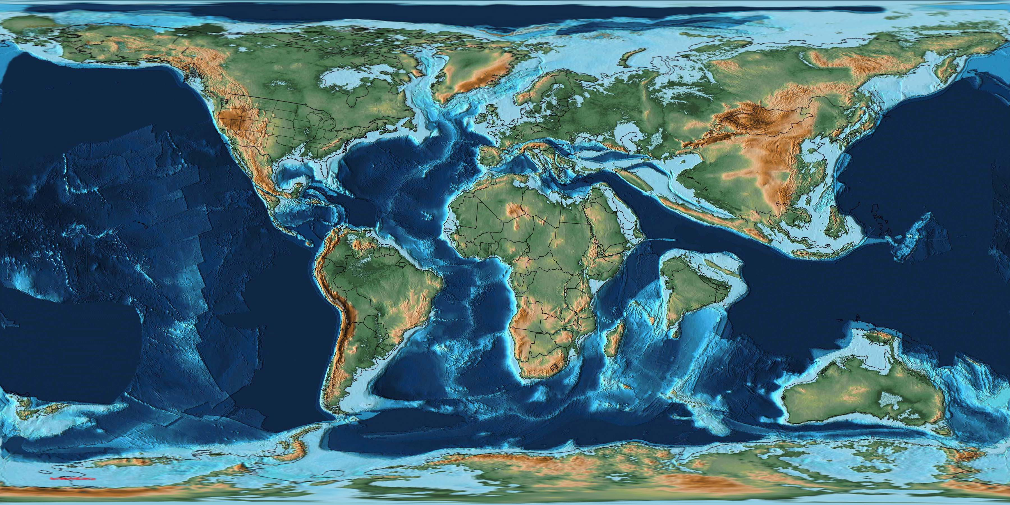
Paleocene (60 Ma)

Slide 5
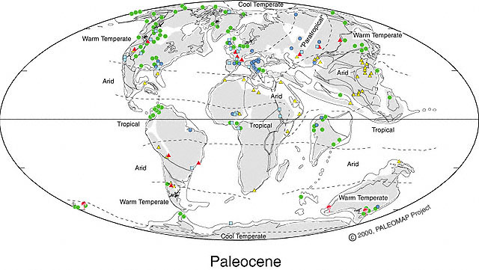
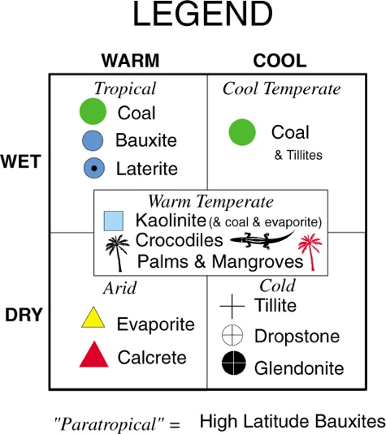

Slide 6
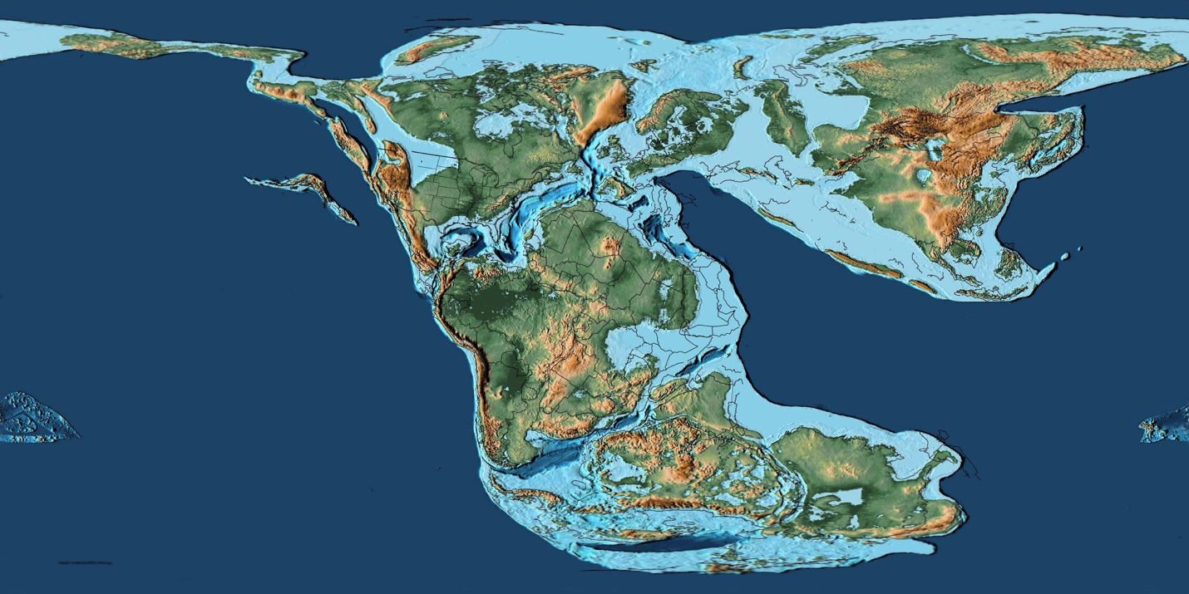
Upper Jurassic (160 Ma)

Slide 7
